Slide 1

DISCLAIMER
The information in this presentation is provided to you by PT. AXAR Technology Raya, solely for informational purposes and does not constitute an offer to buy, sell or issue, or a solicitation of an offer to sell, buy or acquire any securities of the Company in any jurisdiction or an inducement to enter into investment activity, nor may it or any part of it form the basis of or be relied on in connection with any contract or commitment whatsoever. No representations or warranties, express or implied, are made by the Company, any underwriters, any of their respective affiliates, directors, officers, employees, advisors or representatives with respect to, and no reliance should be placed, on the accuracy, fairness or completeness of the information presented or contained in this presentation. By viewing this presentation, you agree that none of the Company, any underwriters, nor any of their respective affiliates, directors, officers, employees, advisors or representatives accepts any responsibility or liability whatsoever for any loss howsoever arising from any information presented or contained in or derived from or omitted from this presentation. The information presented or contained in this presentation was obtained from various sources, including certain third parties, and has not been independently verified, and its accuracy is not guaranteed.
This presentation does not contain all relevant information relating to the Company or its securities, particularly with respect to the risks and special considerations involved with an investment in the securities of the Company. These materials are not an offer of securities for sale. Any public offering will be made by means of a prospectus that may be obtained from the issuer and that will contain detailed information about the company and management, as well as financial statements. This presentation speaks as of its date and the information presented or contained in this presentation is subject to change without notice or update.
This presentation contains statements that constitute forward-looking statements. These statements include descriptions regarding the intent, belief or current expectations of the Company or its officers about the future. These statements can be recognized by the use of words such as “expects,” “plans,” “will,” “estimates,” “projects,” “intends,” or words of similar meaning. Such forward-looking statements are not guarantees of future performance and involve risks and uncertainties, and actual results may differ from those in the forward-looking statements as a result of various factors and assumptions, many of which are beyond the Company’s control. The Company or any of its affiliates, advisors, representatives or underwriters has no obligation and does not undertake to revise forward-looking statements to reflect future events or circumstances.
THE INFORMATION CONTAINED IN THIS DOCUMENT IS HIGHLY CONFIDENTIAL AND MAY NOT BE FORWARDED, PUBLISHED OR DISTRIBUTED, DIRECTLY OR INDIRECTLY, TO ANY OTHER PERSON (WHETHER WITHIN OR OUTSIDE YOUR ORGANIZATION/FIRM) FOR ANY PURPOSE AND MAY NOT BE REPRODUCED IN ANY MANNER WHATSOEVER. ANY FORWARDING, PUBLICATION, DISTRIBUTION OR REPRODUCTION OF THIS DOCUMENT IN WHOLE OR IN PART IS UNAUTHORIZED.
MOBILE
DEVELOPMENT
DAY 1

Slide 2
OBJECTIVES
Firebase
Configurasi Firebase
Firestore
Implementasi Dasar Firestore
Notes:
Save Time....:
The Platform will house/aggregate thousands of DIRECT SUPPLIERS. Buyer members are now abled to easily Pick whats best suitable for them.
Discover...:
Suppliers need to be a registered and verified members. There will be features such as ratings and certifications to boost further.
Grow Business:
Members akan di-empowered dengan sebuah tool digital yang yang tadinya menyerang industri, malah justru membuat mereka bisa menjadi lebih kompetitif di era digital.

Slide 3
Firebase
Apa itu Firebase ?
Firebase adalah suatu layanan dari Google untuk memberikan kemudahan bahkan mempermudah para developer aplikasi dalam mengembangkan aplikasinya. Firebase alias BaaS (Backend as a Service) merupakan solusi yang ditawarkan oleh Google untuk mempercepat pekerjaan developer.
Layanan-layanan yang tersedia dari Firebase ada 2 pilihan, di antaranya:
SPARK : kita bisa menggunakan layanan secara gratis.
BLAZE : kita akan dikenakan biaya sesuai dengan pemakaian layanan.
Notes:
Save Time....:
The Platform will house/aggregate thousands of DIRECT SUPPLIERS. Buyer members are now abled to easily Pick whats best suitable for them.
Discover...:
Suppliers need to be a registered and verified members. There will be features such as ratings and certifications to boost further.
Grow Business:
Members akan di-empowered dengan sebuah tool digital yang yang tadinya menyerang industri, malah justru membuat mereka bisa menjadi lebih kompetitif di era digital.

Slide 4
Firebase
Jenis-jenis layanan firebase :
Firebase Analytics
Firebase Cloud Messaging and Notifications
Firebase Authentication
Firebase Cloud Firestore
Firebase Realtime Database
Firebase Hosting
Dan Lain-lain.
Dalam pembelajaran kali ini kita akan membahas 2 layanan firebase yaitu : Firebase Authentication dan Firebase Cloud Firestore
Notes:
Save Time....:
The Platform will house/aggregate thousands of DIRECT SUPPLIERS. Buyer members are now abled to easily Pick whats best suitable for them.
Discover...:
Suppliers need to be a registered and verified members. There will be features such as ratings and certifications to boost further.
Grow Business:
Members akan di-empowered dengan sebuah tool digital yang yang tadinya menyerang industri, malah justru membuat mereka bisa menjadi lebih kompetitif di era digital.

Slide 5

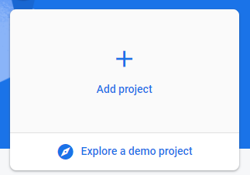
Firebase
Cara membuat Project Firebase :
1. Silahkan buka link berikut : https://firebase.google.com/
2. Silahkan buka login menggunakan email anda dan bukan konsol melalui tombol yang terdapat pada sudut kanan atas :
3. Silahkan tambahkan project dengan men-click tombol berikut :
Notes:
Save Time....:
The Platform will house/aggregate thousands of DIRECT SUPPLIERS. Buyer members are now abled to easily Pick whats best suitable for them.
Discover...:
Suppliers need to be a registered and verified members. There will be features such as ratings and certifications to boost further.
Grow Business:
Members akan di-empowered dengan sebuah tool digital yang yang tadinya menyerang industri, malah justru membuat mereka bisa menjadi lebih kompetitif di era digital.

Slide 6


Firebase
4. Silahkan buat nama project, dan lanjutkan
5. Create Project
6. Silahkan click ikon android yang terdapat pada halaman utama :
7. Silahkan isi nama package atau applicationId android anda, nama package android dapat dilihat di file build.gradle yang terdapat dalam directori android/app/build.gradle
8. Setelah mengisi nama package, anda langsung dapat mendaftarkan aplikasi
Notes:
Save Time....:
The Platform will house/aggregate thousands of DIRECT SUPPLIERS. Buyer members are now abled to easily Pick whats best suitable for them.
Discover...:
Suppliers need to be a registered and verified members. There will be features such as ratings and certifications to boost further.
Grow Business:
Members akan di-empowered dengan sebuah tool digital yang yang tadinya menyerang industri, malah justru membuat mereka bisa menjadi lebih kompetitif di era digital.

Slide 7

Firebase
9. Silahkan download file google-service.json yang telah di-generate ketika mendaftarkan nama package dengan men-click tombol berikut :
NOTE : Pastikan anda mendownload file yang telah di-generate ketika mendaftarkan aplikasi.
10. Letakkan fie google-services.json pada direktori android/app/
NOTE : Pastikan nama file adalah “google-services.json”
Notes:
Save Time....:
The Platform will house/aggregate thousands of DIRECT SUPPLIERS. Buyer members are now abled to easily Pick whats best suitable for them.
Discover...:
Suppliers need to be a registered and verified members. There will be features such as ratings and certifications to boost further.
Grow Business:
Members akan di-empowered dengan sebuah tool digital yang yang tadinya menyerang industri, malah justru membuat mereka bisa menjadi lebih kompetitif di era digital.

Slide 8

Firebase
11. Silahkan buka file build.gradle yang berada pada direktori android/app
12. Tambahkan baris kode berikut di paling bawah :
13. Tambahkan baris kode berikut pada dependencies :
14. Tambakan baris kode berikut pada dependencies di build.gradle yang berada pada direktori android/
15. Kemudian next, dan lanjutkkan ke console firebase.
Notes:
Save Time....:
The Platform will house/aggregate thousands of DIRECT SUPPLIERS. Buyer members are now abled to easily Pick whats best suitable for them.
Discover...:
Suppliers need to be a registered and verified members. There will be features such as ratings and certifications to boost further.
Grow Business:
Members akan di-empowered dengan sebuah tool digital yang yang tadinya menyerang industri, malah justru membuat mereka bisa menjadi lebih kompetitif di era digital.

Slide 9


Firebase FireStore
Cloud Firestore adalah database dari Firebase untuk pengembangan aplikasi seluler. Database ini melanjutkan keberhasilan Realtime Database dengan model data baru yang lebih intuitif. Cloud Firestore juga memiliki fitur kueri yang lebih lengkap dan lebih cepat, serta penskalaan yang lebih mendalam dibandingkan dengan Realtime Database.
Berikut ini adalah cara mengimplementasikan cloud firestore :
1. Silahkan Click tombol berikut :
2. Kemudian click tombol berikut :
Notes:
Save Time....:
The Platform will house/aggregate thousands of DIRECT SUPPLIERS. Buyer members are now abled to easily Pick whats best suitable for them.
Discover...:
Suppliers need to be a registered and verified members. There will be features such as ratings and certifications to boost further.
Grow Business:
Members akan di-empowered dengan sebuah tool digital yang yang tadinya menyerang industri, malah justru membuat mereka bisa menjadi lebih kompetitif di era digital.

Slide 10

Firebase Firestore
3. Silahkan pilih production mode.
4. Pilih lokasi sesuai keinginan anda.
5. Tekan tombol enable dan tunggu proses hingga selesai.
6. Silahkan buat collection pertama anda.
Notes:
Save Time....:
The Platform will house/aggregate thousands of DIRECT SUPPLIERS. Buyer members are now abled to easily Pick whats best suitable for them.
Discover...:
Suppliers need to be a registered and verified members. There will be features such as ratings and certifications to boost further.
Grow Business:
Members akan di-empowered dengan sebuah tool digital yang yang tadinya menyerang industri, malah justru membuat mereka bisa menjadi lebih kompetitif di era digital.

Slide 11
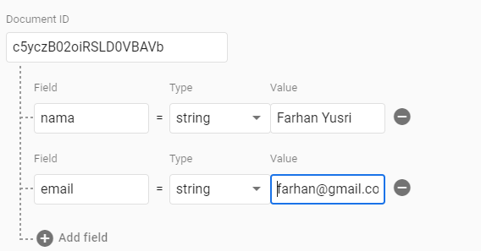
Firebase Firestore
Cara membuat collection :
1. Silahkan click tombol seperti gambar berikut :
2. Silahkan buat id atau nama colllection anda. contoh : users, kemudian tekan “next”
3. Silahkan buat id dokumen, anda dapat mengguna id secara auto
4. Silahkan buat dokumen pertama ada sebagai berikut :
nama dan email dapat diisi secara bebas
5. Tekan tombol “save”
Notes:
Save Time....:
The Platform will house/aggregate thousands of DIRECT SUPPLIERS. Buyer members are now abled to easily Pick whats best suitable for them.
Discover...:
Suppliers need to be a registered and verified members. There will be features such as ratings and certifications to boost further.
Grow Business:
Members akan di-empowered dengan sebuah tool digital yang yang tadinya menyerang industri, malah justru membuat mereka bisa menjadi lebih kompetitif di era digital.

Slide 12
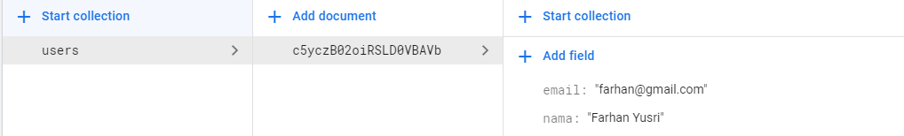
Firestore
Berikut ini adalah hasil pembuatan dokumen peratama.
dokumen merupakan string unik dari suatu kumpulan data, dalam contoh diatas id : c5yczB02oiRSLD0VBAVb memiliki kumpulan data yaitu : nama dan email
collection merupakan string unik dari suatu kumpulan dokumen.
Notes:
Save Time....:
The Platform will house/aggregate thousands of DIRECT SUPPLIERS. Buyer members are now abled to easily Pick whats best suitable for them.
Discover...:
Suppliers need to be a registered and verified members. There will be features such as ratings and certifications to boost further.
Grow Business:
Members akan di-empowered dengan sebuah tool digital yang yang tadinya menyerang industri, malah justru membuat mereka bisa menjadi lebih kompetitif di era digital.

Slide 13
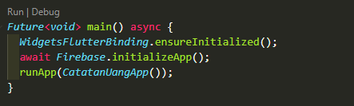
Program dasar firestore di Flutter
Untuk mengimplementasikan seluruh produk dari firebase, kita harus menginisialisasikan firebase di dalam project kita.
Berikut ini adalah untuk menginisialisasikan firebase :
1. Tambahkan plugin firebase_core: ^0.7.0 di dalam file pubspec.yaml
2. Ubah method main menjadi Future<void> dan tambahkan kode sebagai berikut :
3. Silahkan build ulang aplikasi anda.
Notes:
Save Time....:
The Platform will house/aggregate thousands of DIRECT SUPPLIERS. Buyer members are now abled to easily Pick whats best suitable for them.
Discover...:
Suppliers need to be a registered and verified members. There will be features such as ratings and certifications to boost further.
Grow Business:
Members akan di-empowered dengan sebuah tool digital yang yang tadinya menyerang industri, malah justru membuat mereka bisa menjadi lebih kompetitif di era digital.

Slide 14
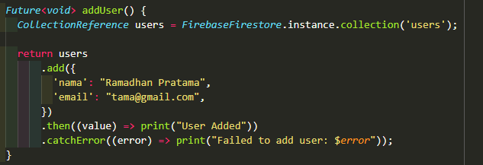
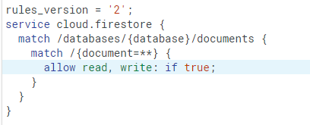
Implementasi Sedarhanan Firestore
Berikut ini adalah potongan method untuk menambahkan data nama dan email pada collection “user” dengan id dokument auto
Note : pastikan rules dalam firestore ada sudah bernilai true untuk menyimpan data ke firestore.
Notes:
Save Time....:
The Platform will house/aggregate thousands of DIRECT SUPPLIERS. Buyer members are now abled to easily Pick whats best suitable for them.
Discover...:
Suppliers need to be a registered and verified members. There will be features such as ratings and certifications to boost further.
Grow Business:
Members akan di-empowered dengan sebuah tool digital yang yang tadinya menyerang industri, malah justru membuat mereka bisa menjadi lebih kompetitif di era digital.

Slide 15
DISCLAIMER
The information in this presentation is provided to you by PT. AXAR Technology Raya, solely for informational purposes and does not constitute an offer to buy, sell or issue, or a solicitation of an offer to sell, buy or acquire any securities of the Company in any jurisdiction or an inducement to enter into investment activity, nor may it or any part of it form the basis of or be relied on in connection with any contract or commitment whatsoever. No representations or warranties, express or implied, are made by the Company, any underwriters, any of their respective affiliates, directors, officers, employees, advisors or representatives with respect to, and no reliance should be placed, on the accuracy, fairness or completeness of the information presented or contained in this presentation. By viewing this presentation, you agree that none of the Company, any underwriters, nor any of their respective affiliates, directors, officers, employees, advisors or representatives accepts any responsibility or liability whatsoever for any loss howsoever arising from any information presented or contained in or derived from or omitted from this presentation. The information presented or contained in this presentation was obtained from various sources, including certain third parties, and has not been independently verified, and its accuracy is not guaranteed.
This presentation does not contain all relevant information relating to the Company or its securities, particularly with respect to the risks and special considerations involved with an investment in the securities of the Company. These materials are not an offer of securities for sale. Any public offering will be made by means of a prospectus that may be obtained from the issuer and that will contain detailed information about the company and management, as well as financial statements. This presentation speaks as of its date and the information presented or contained in this presentation is subject to change without notice or update.
This presentation contains statements that constitute forward-looking statements. These statements include descriptions regarding the intent, belief or current expectations of the Company or its officers about the future. These statements can be recognized by the use of words such as “expects,” “plans,” “will,” “estimates,” “projects,” “intends,” or words of similar meaning. Such forward-looking statements are not guarantees of future performance and involve risks and uncertainties, and actual results may differ from those in the forward-looking statements as a result of various factors and assumptions, many of which are beyond the Company’s control. The Company or any of its affiliates, advisors, representatives or underwriters has no obligation and does not undertake to revise forward-looking statements to reflect future events or circumstances.
THE INFORMATION CONTAINED IN THIS DOCUMENT IS HIGHLY CONFIDENTIAL AND MAY NOT BE FORWARDED, PUBLISHED OR DISTRIBUTED, DIRECTLY OR INDIRECTLY, TO ANY OTHER PERSON (WHETHER WITHIN OR OUTSIDE YOUR ORGANIZATION/FIRM) FOR ANY PURPOSE AND MAY NOT BE REPRODUCED IN ANY MANNER WHATSOEVER. ANY FORWARDING, PUBLICATION, DISTRIBUTION OR REPRODUCTION OF THIS DOCUMENT IN WHOLE OR IN PART IS UNAUTHORIZED.
THANK YOU

